Slide 1
Computer Programming week 2
Instructor:
Nida Munawar
Lecturer
(Computer Science Department)
National University- FAST (KHI Campus)

Slide 2
acknowledgment
- Publish material by Virtual University of Pakistan.
- Publish material by Deitel & Deitel.
- Publish material by Robert Lafore.

Slide 3
Week two, class one
What is an Object?

Slide 4
Object
Technical Definition:
- “An Object is an Instance of a class”
- “An Object is the implementation of a class”
In general we say :
“ Any tangible thing for which we want to save Information”
Now onwards we treat object technically.

Slide 5






Some Examples
SHOES
Female sandal
Casuals
Men sandal
Formal
Loafers
Pumpies

Slide 6





Humans

Slide 7




FISH

Slide 8
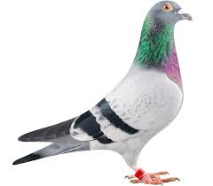


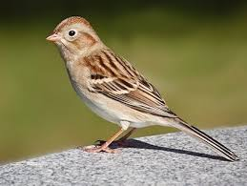
BIRD

Slide 9




Animal

Slide 10
Discussion
- Object belongs to a group.
- Which similar.
- Have some common attributes.
- Have some common behaviors.
- We can categorized objects on some basic features …. ?

Slide 11
Exercise
Are there any ‘objects’ in this classroom?

Slide 12
Exercise
Are there any ‘objects’ in this classroom
Chair
Multimedia
Student
Teacher

Slide 13
Exercise
Possible Objects in this university?

Slide 14
Class
- Collection of Similar object.
- The objects that share some common features.
- It is the a design of an object.
- It is a detail of an object.
- It tell us what an object contains in it.
Technical Definition:
“ A class is blueprint of an object”

Slide 15
Summarize
A class :
It’s a blue print .
It’s a design or template.
An Object:
Its an instance of a class.
Implementation of a class.
NOTE: Classes are invisible, object are visible

Slide 16

Class
Accelerator Pedal
Brake Pedal
Steering Wheel
User-friendly “interfaces” to control the car
Their mechanism is housed inside the engineering drawings or blueprints

Slide 17
Class
Suppose you want to drive a car and make it go faster by pressing down on its accelerator pedal.
What must happen before you can do this?

Slide 18
Class
before you can drive a car, someone has to design it and build it.
A car typically begins as engineering drawings
Unfortunately, you cannot drive the engineering drawings of a car—before you can
drive a car, it must be built from the engineering drawings that describe it
A completed car will have an actual accelerator pedal to make the car go faster. But even that’s not
enough—the car will not accelerate on its own, so the driver must press the accelerator
pedal to tell the car to go faster.

Slide 19
Now let’s use our car example to introduce the key object-oriented programming concepts
Performing a task in a program requires a function
The function hides from its user the complex tasks that it performs, just as the accelerator
pedal of a car hides from the driver the complex mechanisms of making the car go
Faster
In C++, we begin by creating a program unit called a class to house a function, just
as a car’s engineering drawings house the design of an accelerator pedal.

Slide 20
Class
Just as you cannot drive an engineering drawing of a car, you cannot “drive” a class.
Just as someone has to build a car from its engineering drawings before you can actually
drive the car, you must create an object of a class before you can get a program to perform the
tasks the class describes.
Note also that just as many cars can be built from the same engineering
drawing, many objects can be built from the same class

Slide 21
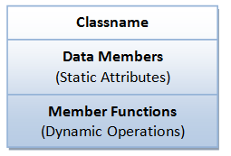
A Class is a 3-Compartment Box encapsulating Data and Functions
Classname (or identifier): identifies the class.
Data Members or Variables (or attributes, states, fields): contains the attributes of the class.
Member Functions (or methods, behaviors, operations): contains the dynamic operations of the class.

Slide 22
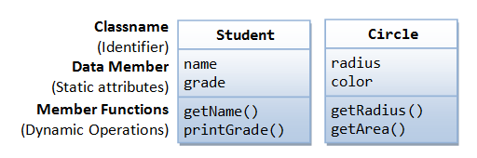
Example of classes

Slide 23
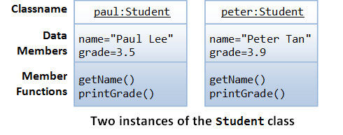
Example of objects
Each object of a class maintains its own copy of its attributes in memory

Slide 24
Classes
class Car
{
void accelerate() { \\ logic for acceleration }
void brake() { \\ logic for brakes }
};

Slide 25
classes
class Car
{
string model; int numOfDoors; string color;
void accelerate() { \\ logic for acceleration }
void brake() { \\ logic for brakes }
};

Slide 26
How to use the car?
int main()
{ Car car; car.accelerate();
}

Slide 27
Generalized Class
- The class that only exhibits the common features of its objects.
Examples:
- ANIMAL
- BIRDS
- HUMAN
- No object of generalized class is found.

Slide 28








Specialized Class
- The class that exhibits different or unique features (behaviors)
ANIMAL (Generalized)
Specialized:
Mammals
Cats
Dog
ANIMAL
WILD PET
CAT CAT
Lion Streat Cat Persian Siamese

Slide 29
Type of classes
1- Abstract Class: The classes we make against abstract concepts are called abstract classes. Abstract Classes can not exist standalone.
2- Concrete Class: The entities that actually we see in our real world are called concrete objects and classes made against these objects are called concrete classes.
3- Sub-type: Sub-typing means that derived class is behaviorally compatible with the base class. Also known as Extension. Type B is called a subtype of type A if an instance of B can be used in every situation where an instance of A is required. In a way, the subtype does everything the supertype does and then some more, so it can be used as substitute for the “parent” or “supertype”.
4- Specialized class: Specialization means that derived class is behaviorally incompatible with the base class

Slide 30
While abstraction reduces complexity by hiding irrelevant detail, generalization reduces complexity by replacing multiple entities which perform similar functions with a single construct.

Slide 31
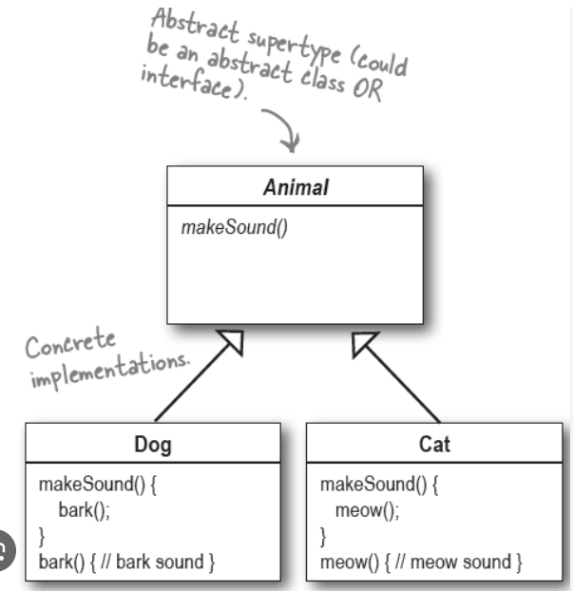
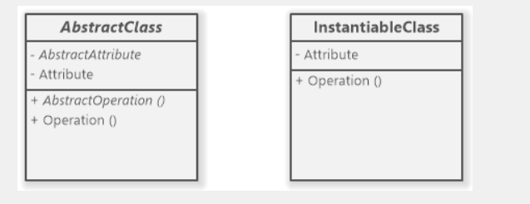
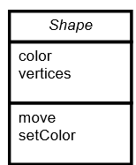
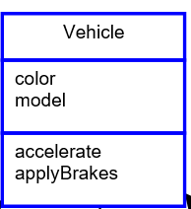
Abstract Class

Slide 32
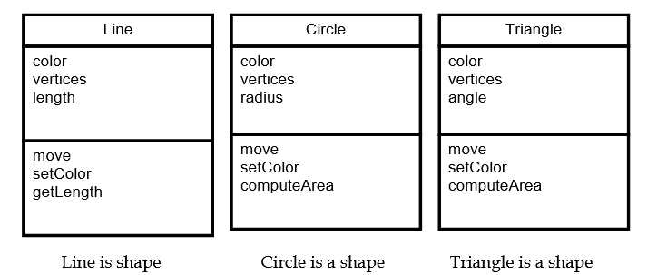
Concrete Class

Slide 33


Class Activity
5- Pen
3- Parents
4- Playground
2- Classroom
0/1- Library
6- Book
7- Bag
8- Student
9 Teacher

Slide 34
Questions
1- Identify at least 3 behaviors and related data for an object.
2- Draw an object interaction model based on the objects .

Slide 35
Solution
Teaches
Student
Plays-in
Playground
Teacher
Has
Book
Pen
School Bag

Slide 36
Question
Draw a class diagram that models the relationships between the following classes: Mall, Store, Sales Person, Department, Manager, Merchandise, Store Catalog, Store Website, and Customer.

Slide 37
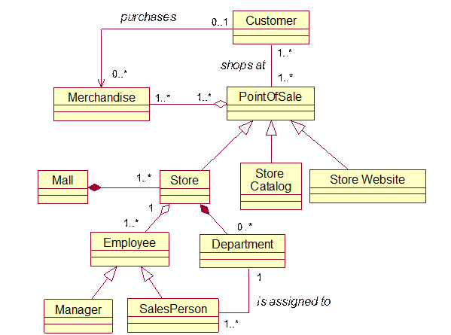
Solution

Slide 38
Question
Identify the classes related to environment

Slide 39

Environment: University

Slide 40
Environment: Hospital

Slide 41
Environment: Office

Slide 42
Environment: University
Write a program to enter record (Name, StudentID, CGPA & Warning Count) of 5 students with appropriate functions.

Slide 43
Week 3 lec :1

Slide 44
Class vs Struct in c++
Members of a class are private by default and members of struct are public by default
Classes can be inherited whereas structures cannot
Class is pass-by-reference and Struct is pass-by-copy, it means that, Class is a reference type and its object is created on the heap memory where as structure is a value type and its object is created on the stack memory
A structure can't be abstract, a class can be

Slide 45
Difference between C structures and C++ structures
Member functions inside structure: Structures in C cannot have member functions inside structure but Structures in C++ can have member functions along with data members.
Direct Initialization: We cannot directly initialize structure data members in C but we can do it in C++
Using struct keyword: In C, we need to use struct to declare a struct variable. In C++, struct is not necessary
Data Hiding: C structures do not allow concept of Data hiding but is permitted in C++ as C++ is an object oriented language whereas C is not.

Slide 46
Access Modifiers
One of the main features of object-oriented programming languages such as C++ is data hiding.
Data hiding refers to restricting access to class members

Slide 47
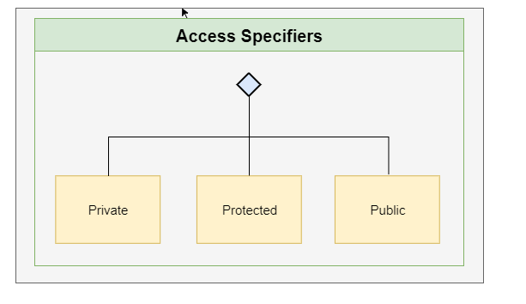
Types of C++ Access Modifiers
In C++, there are 3 access modifiers:
In C++, class members are considered private when no access modifier is used

Slide 48
public Access Modifier
The public keyword is used to create public members (data and functions).
The public members are accessible from any part of the program.
The public members of a class can be accessed from anywhere in the program using the direct member access operator (.) with the object of that class.
class MyClass { // The class public: // Access specifier // class members goes here };

Slide 49
public Access Modifier
class Car{
public:
void accelerate()
{ \\ logic for acceleration } void brake() { \\ logic for brakes }
};
int main()
{ Car car; car.accelerate();
}

Slide 50
private Access Modifier
The class members declared as private can be accessed only by the member functions inside the class. They are not allowed to be accessed directly by any object or function outside the class.
In C++, class members are considered private when no access modifier is used

Slide 51
protected Access Modifier
Protected access modifier is similar to private access modifier in the sense that it can’t be accessed outside , the difference is that the class members declared as Protected can be accessed by any subclass(derived class) of that class as well.

Slide 52
Getter/Setter Functions
A class’s private data members can be manipulated only by member functions of that Class. These member function names need not begin with set or get, but this naming convention is common
Getter functions (or accessor functions) are used to read value of a private member of some class
Setter functions (or mutator functions) are used to modify the value of a private member of some class
Set functions are also sometimes called mutators (because they mutate, or change, values), and get functions are also sometimes called accessors (because they access values).
Providing public set and get functions allows clients of a class to access the hidden data, but only indirectly

Slide 53
Example
class BankAccount
{
int accountNo; private: int PIN;
public:
int accountType;
}

Slide 54
class BankAccount
{
int PIN; //private variable public: int get_PIN() { return PIN; }
}

Slide 55
class BankAccount
{
int accountNo; //private variable public: void set_accountNo(int num) { accountNo = num; }
}

Slide 56
Data Hiding
Declaring data members with access specifier private is known as data hiding
Data hiding is a technique especially practiced in object-oriented programming (OOP).Data hiding is hiding the details of internal data members of an object.
Data hiding is also known as Information hiding
The use of getter & setter functions to read or modify class variables

Slide 57
Encapsulation
Encapsulation is a process of capsulation of data and methods into a combined single unit.
In C++, encapsulation is used along with the classes and access specifier concept.
Encapsulation is the process of combining data and function into a single unit called class.
Using the method of encapsulation the programmer cannot access the class directly.
You can assume it as a protective wrapper that stops random access of code defined outside that wrapper.

Slide 58
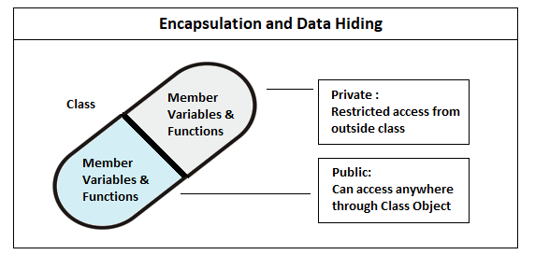
Encapsulation binds the data & functions together which keeps both safe from outside interference. Data encapsulation led to data hiding.

Slide 59
#include<iostream>
using namespace std;
class Encapsulation
{
private:
// data hidden from outside world
int num;
public:
// function to set value of
// variable x
void set(int a)
{
num =a;
}

Slide 60
} // function to return value of
// variable x
int get()
{
return num;
};
// main function
int main()
{
Encapsulation obj;
obj.set(5);
cout<<obj.get();
return 0;
}

Slide 61
Placing a Class in a Separate File for Reusability
Header Files
Each of the previous examples consists of a single .cpp file, also known as a source-code file, that contains a class definition and a main function.
When building an object-oriented C++ program, it’s customary to define reusable source code (such as a class) in a file that by convention has a .h filename extension—known as a header file.
Programs use #include preprocessor directives to include header files and take advantage of reusable software components, such as type string provided in the C++ Standard Library

Slide 62
GradeBook.h
#include <iostream>
#include <string> // class GradeBook uses C++ standard string class
using namespace std;
class GradeBook{
public:
void setCourseName( string name ) {
courseName = name; }
string getCourseName() {
return courseName; }
void displayMessage(){
cout << "Welcome to the grade book for\n" << getCourseName()<< "!" << endl;
}
private:
string courseName; };

Slide 63
main.cpp
#include <iostream>
#include "GradeBook.h" // include definition of class GradeBook
using namespace std;
int main(){
GradeBook gradeBook1;
gradeBook1. setCourseName("oop");
cout << "gradeBook1 created for course: " << gradeBook1.getCourseName()<< endl;
} // end main

Slide 64
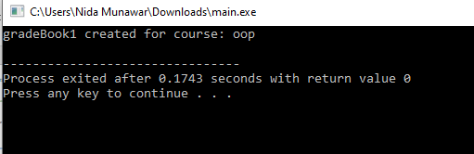

Slide 65
Placing a Class in a Separate File for Reusability
A header file such as GradeBook.h cannot be used to begin program execution, because it does not contain a main function.
Line 2 instructs the C++ preprocessor to replace the directive with a copy of the contents of GradeBook.h (i.e., the GradeBook class definition) before the program is compiled.
When the source-code file.cpp is compiled, it now contains the GradeBook class definition (because of the #include),

Slide 66
Placing a Class in a Separate File for Reusability
Notice that the name of the GradeBook.h header file in line 4 is enclosed in
quotes (" ") rather than angle brackets (< >). Normally, a program’s source-code files and
user-defined header files are placed in the same directory. When the preprocessor encounters a header file name in quotes, it attempts to locate the header file in the same directory as the file in which the #include directive appears

Slide 67
Data Validation/Validity Checking
Data validation is performed to ensure that class members are provided data in “correct format”
Validation rules vary according to requirements
Where to perform validation?

Slide 68
Data Validation/Validity Checking
void setCourseName(string name) // a setter function
{
if ( name.length() <= 25 )
courseName = name;
if ( name.length() > 25 )
{
courseName = name.substr( 0, 25 );
cout << "Name exceeds max length (25)“ << endl;
}
}

Slide 69
Separating interface from implementation
It’s a good practice to define member functions outside class definition
Implementation details can be hidden from client code
Do not write client code that depends on class’ implementation

Slide 70
Separating interface from implementation
// A.h
class A{
public:
int a;
void getA();
};

Slide 71
Separating interface from implementation
//B.cpp
#include <iostream>
#include "A.h"
using namespace std;
void A::getA()
{
a = 10;
cout << a;
}

Slide 72




















Separating interface from implementation
//Test.cpp
//place all files within same project
#include "A.h"
int main(){
A c;
c.getA();
}

Slide 73
Example: Bank Account
Create an Account class to represent customers’ bank accounts. Include a data member of type int to represent the account balance.
You need to initialize the data members. But while doing so, you should validate the initial balance to ensure that it’s greater than or equal to 0. If not, set the balance to 0 and display an error message indicating that the initial balance was invalid.
Provide three member functions. Member function credit should add an amount to the current balance. Member function debit should withdraw money from the Account and ensure that the debit amount does not exceed the Account’s balance. If it does, the balance should be left unchanged and the function should print a message indicating "Debit amount exceeded account balance.“ Member function getBalance() should return the current balance. Create a program that creates two Account objects and tests the member functions of class Account.

Slide 74
exercise
A bank wants a simple application module to manage the accounts of its customers. For every new customer, the app must let us fill in the details including his Name, Age, NIC#, Address, Opening Balance, Current Balance, Contact# & PIN. These details may be modified later except for the PIN. At any given time, the customer can check his balance.
Also, tax must be calculated (Tax is 0.15% of the current balance for customers aged 60 or above and 0.25% for all other customers).

